Slide 1

Machine Learning for Cyber Security
Week 6
Mesut GUVEN, Ph.D.

Slide 2
information
Exams; 55% (Mid 25% + Final 30%), Homeworks; 15%, Project; 30%
In homeworks, you will be expected to examine SCI/E papers (published in last 3 years).
In Final Project, you will implement an AI/ML-based cyber solution.
Textbook:
- Getting Started with Deep Learning: Programming and Methodologies using Python
- Hands-On Machine Learning with Scikit-Learn, Keras, and TensorFlow, 2nd Edition
Code: GitHub
Videos: YouTube

Slide 3
UNIT 6: CNN, Deep learning
Learning Outcomes;
- have a better understanding of CNN,
- have a better understanding of Deep Learning,

Slide 4
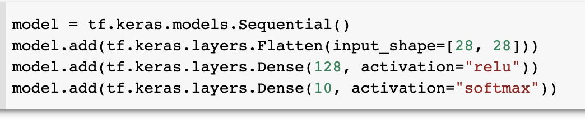
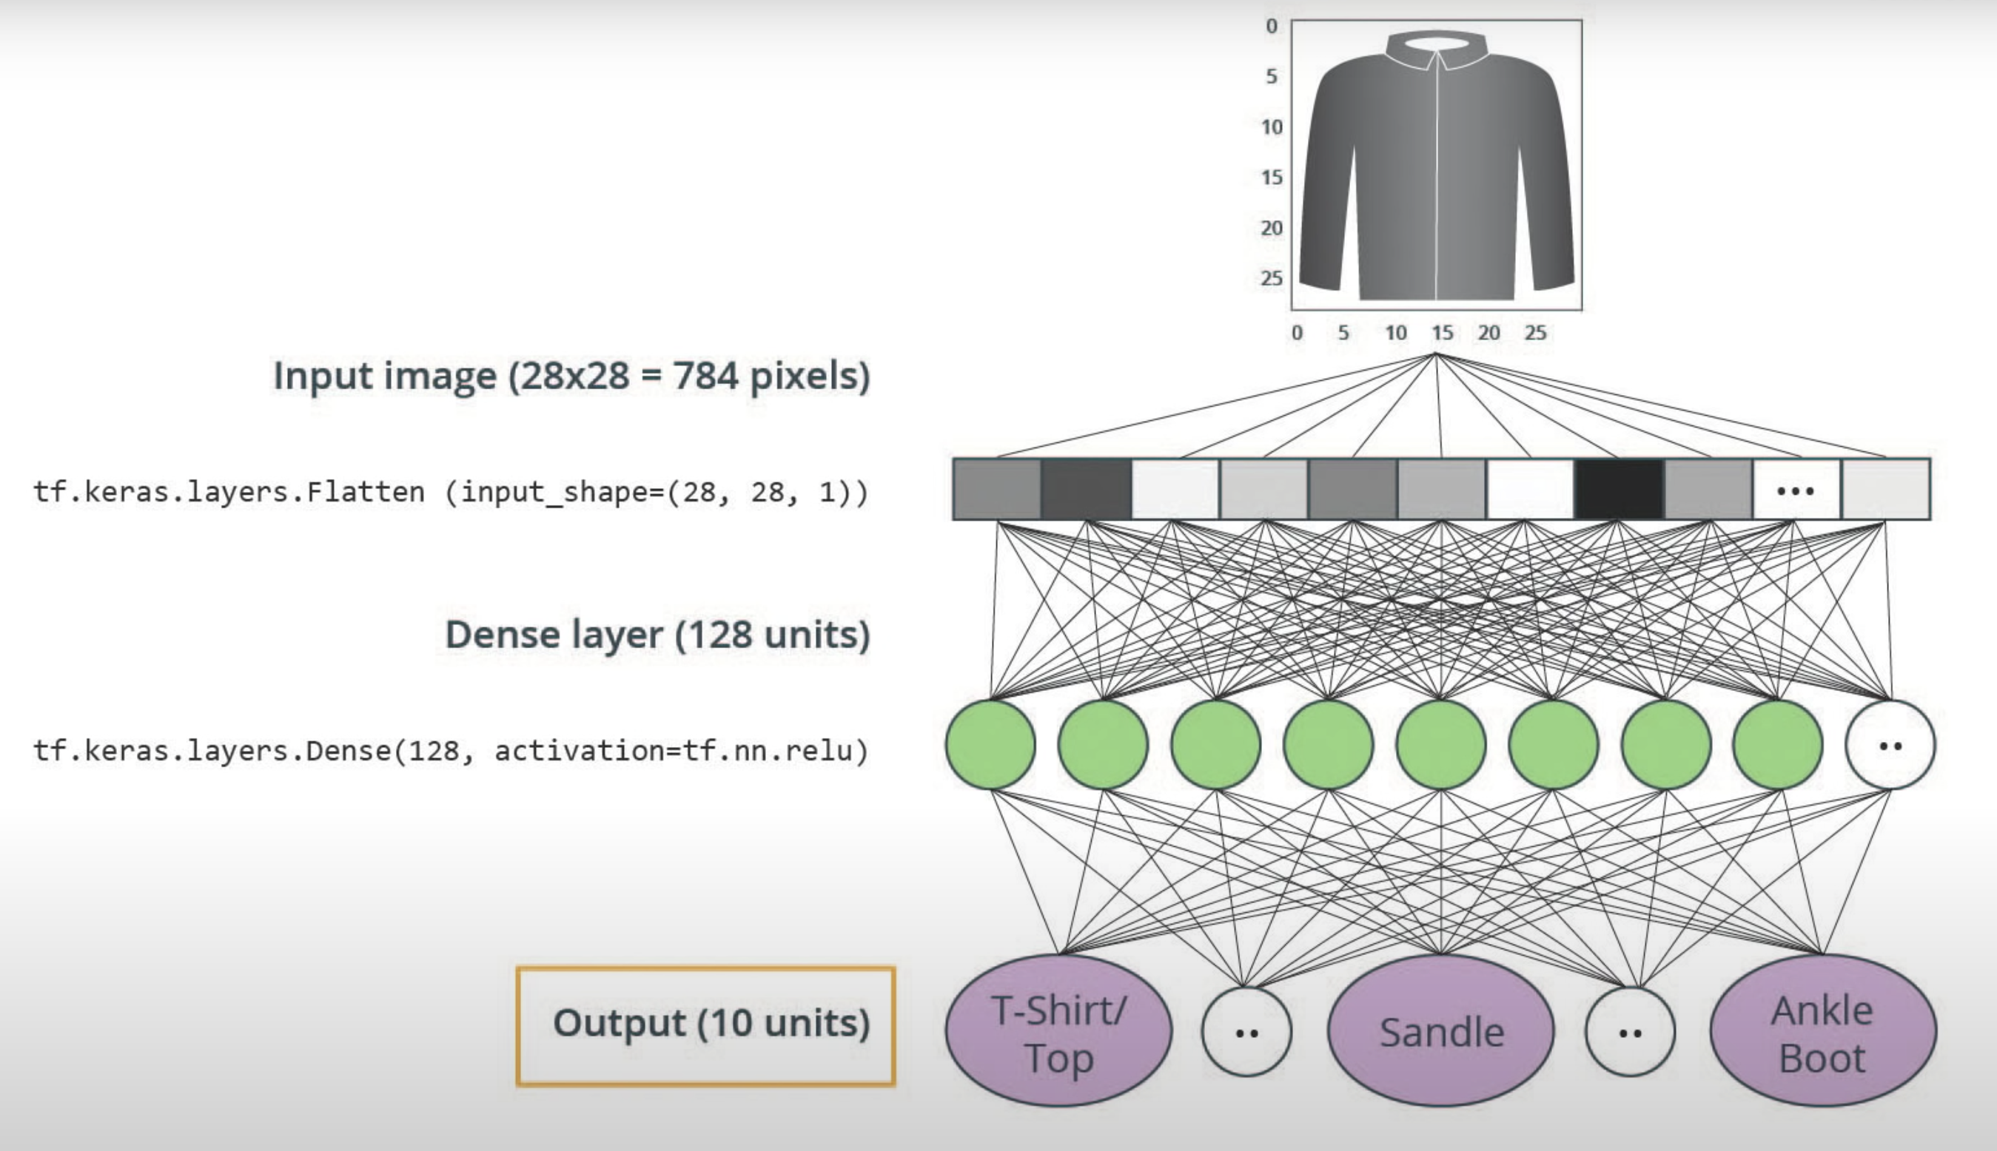
Convolutional neural network
In the previous lesson, we trained a sequential model for image classification task.
It performed well (approximately 90% accuracy both on training and testing set).
HOW CAN WE MAKE IT PERFORM EVEN BETTER?
SOLUTION:
CONVOLUTIONAL NEURAL NETWORKS (CNNs)

Slide 5
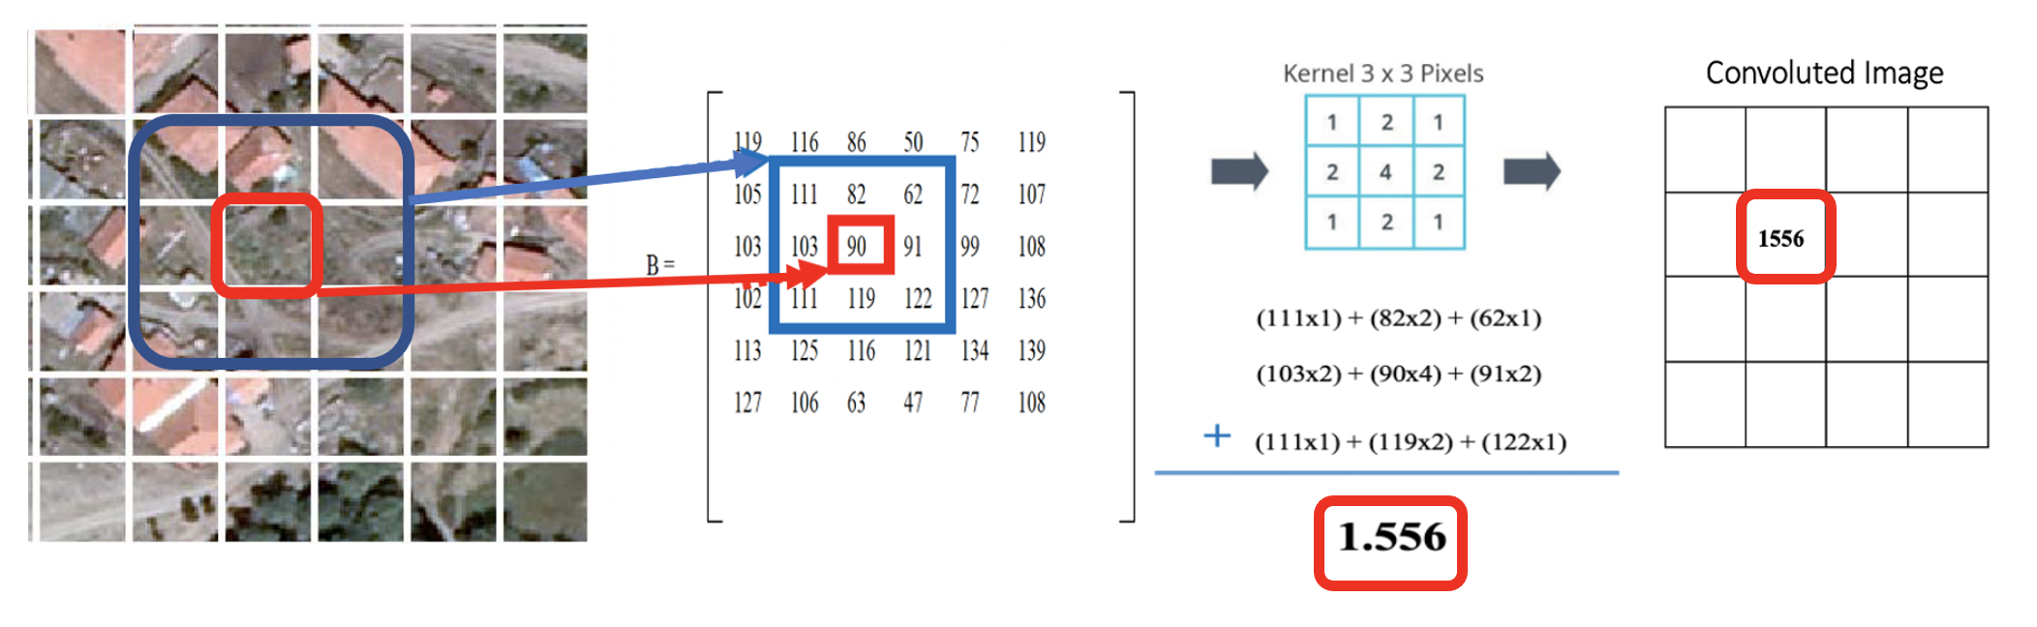
Convolutional neural network
Convolutional neural networks managed to achieve superhuman performance on visual tasks since we have big-sized classified image datasets and computation power for training deep networks.
Convolution is an operator that slides one function over another to measure the integral of their element wise multiplication.

Slide 6
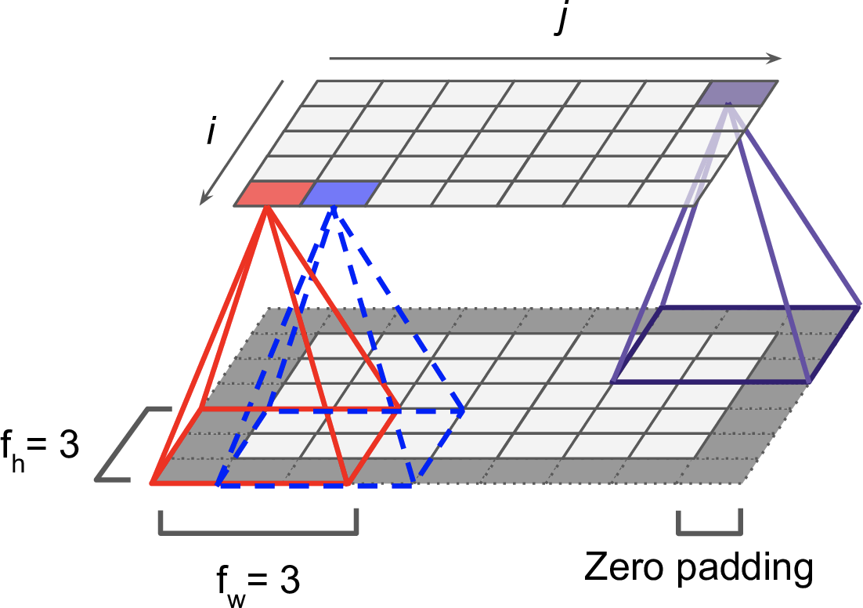
Convolutional neural network
Note, when data is loaded it is stored as 2D array. Suppose we have an image like below (if it is colored image, it has 3 components, respectively; RGB-Red, Green, Blue), The greyscale version is represented with “B”.
If we use a kernel function of 3x3, the edge pixels can be represented in the output product of the convolution. To mitigate this, some zeros are added to the perimeter of the matrice “B”, This called zero padding, and Keras enables to use a padding='same’ parameter inside the code.

Slide 7
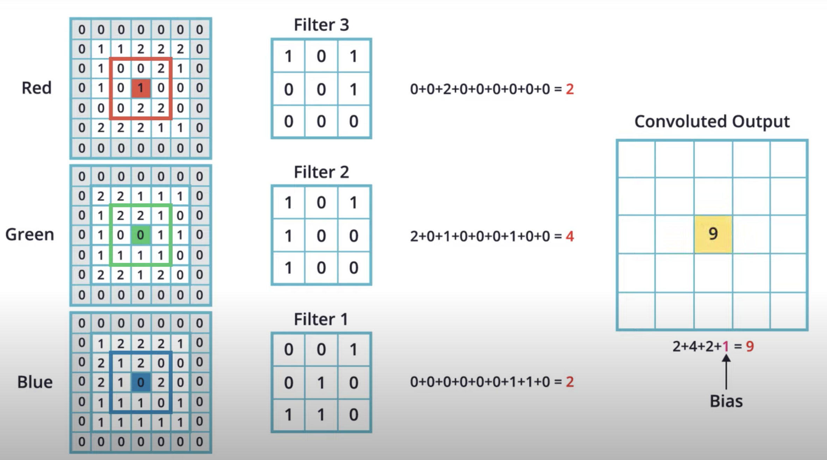
Convolutional neural network
The filter (kernel) used in the colored image convolution has also three dimensions (3D filters).
Computation; different filters are used for multiplication, and all results are summed.
The output convoluted image of a colored image is also a 2D array of the same size (if padding is SAME).
Convolution with a single 3D filter produces a single convoluted output. However, when working with CNNs, it is customary to use more than one 3D filter.

Slide 8
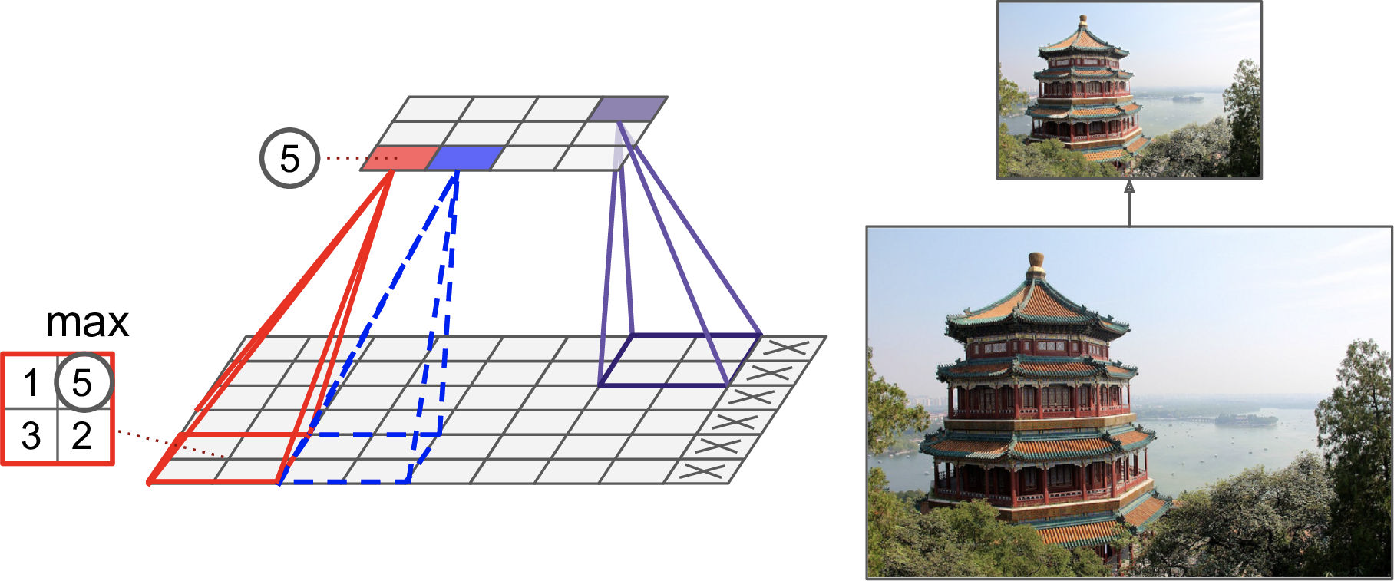
Convolutional neural network
The second key concept of the CNNs is pooling (subsampling). Pooling is used for reducing the computational load, the memory usage, and the number of parameters.
Suppose we have a 2x2 pooling kernel, with a stride of 2, and no padding. Only the max input value in each receptive field makes it to the next layer, while the other inputs are dropped (ex. 1, 5, 3, 2; only 5 is saved and others dropped).
Because of the stride of 2, the output image has half the height and half the width of the input image (rounded down since we use no padding)

Slide 9

Convolutional neural network
The main function of the CNNs is extract some usefull features in the process and feed the neural network with those information (seen in the figure above).

Slide 10
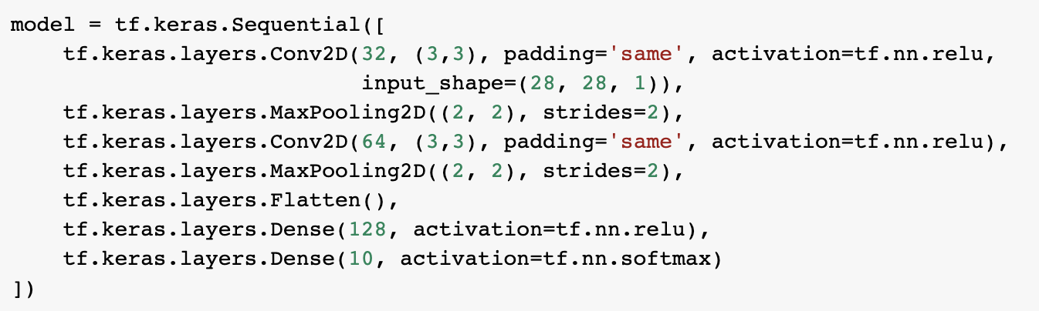
Building a classifier with CNN Structure
First Conv2D takes one image (28x28 grayscale images). and produces 32 convoluted output images (28x28). After that, convoluted output images are subsampled by Maxpooling2D (Reduced the size to 14x14).
Next Conv2D takes 32 images but, outputs 64 images of the same input size (14x14). Followed by a pooling process which reduces the image sizes by half (7x7).
Finally, images (2D arrays) flattened (remember NNs accepts 1D arrays) and feed the NN.

Slide 11
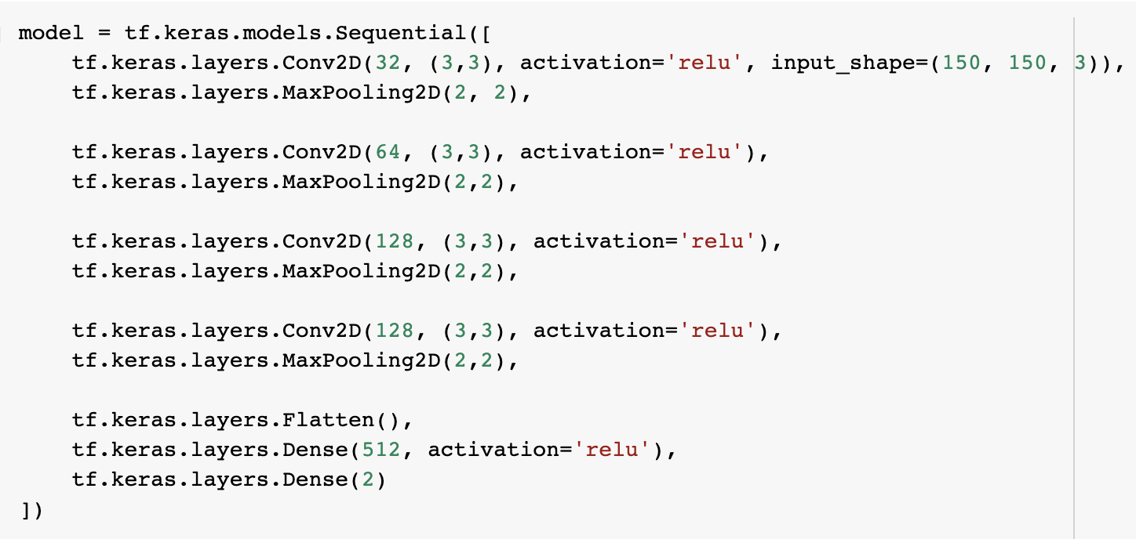
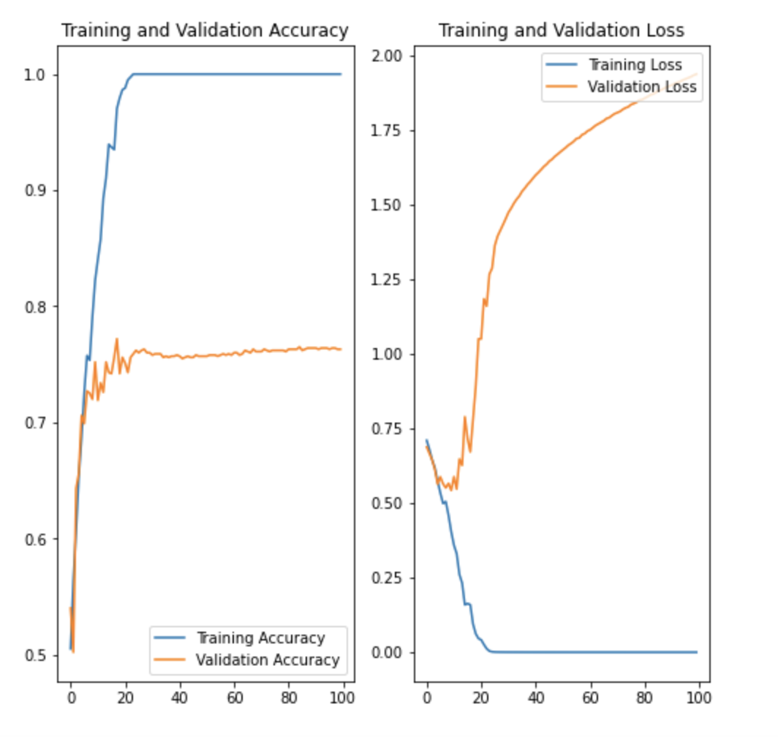
overfitting
Another model is presented with famous Dogs vs Cats dataset (Codes available at GitHub).
The model uses 4 convolutional layers/pooling layers, then passes the information to dense layer of 512 neurons.
Since Dogs vs Cats dataset have two class, the output layer has two dense layer with ReLU.
As we can see from the plots, training accuracy and validation accuracy are off by large margin and our model has achieved only around 70% accuracy on the validation set.
This is a clear indication of overfitting. Once the training and validation curves start to diverge, our model has started to memorize the training data and is unable to perform well on the validation data.

Slide 12
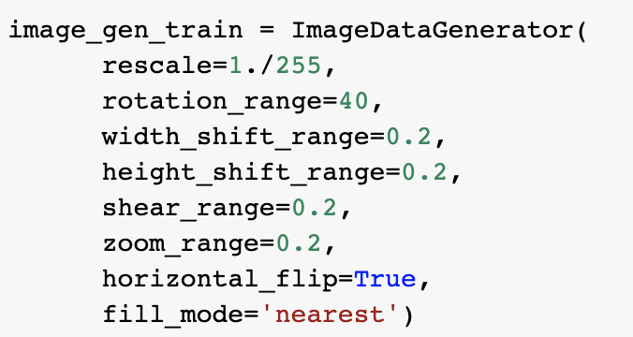
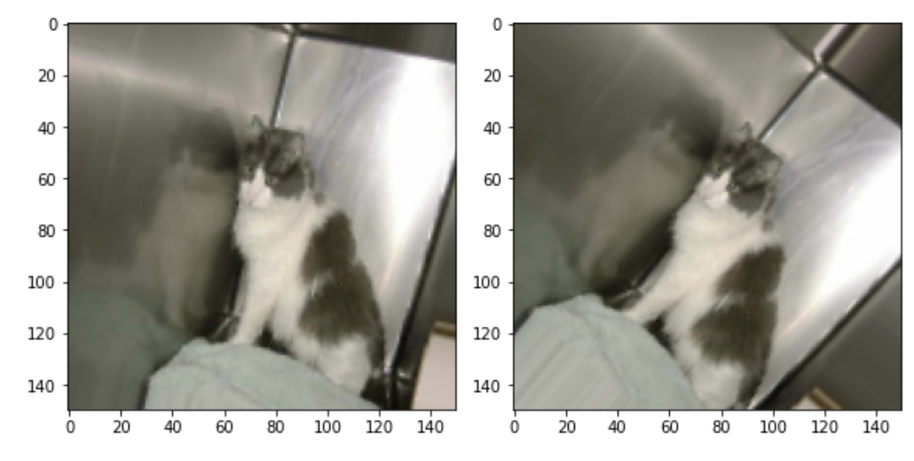
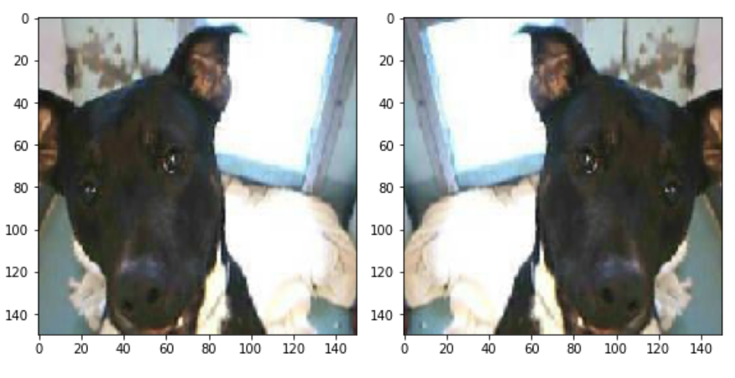
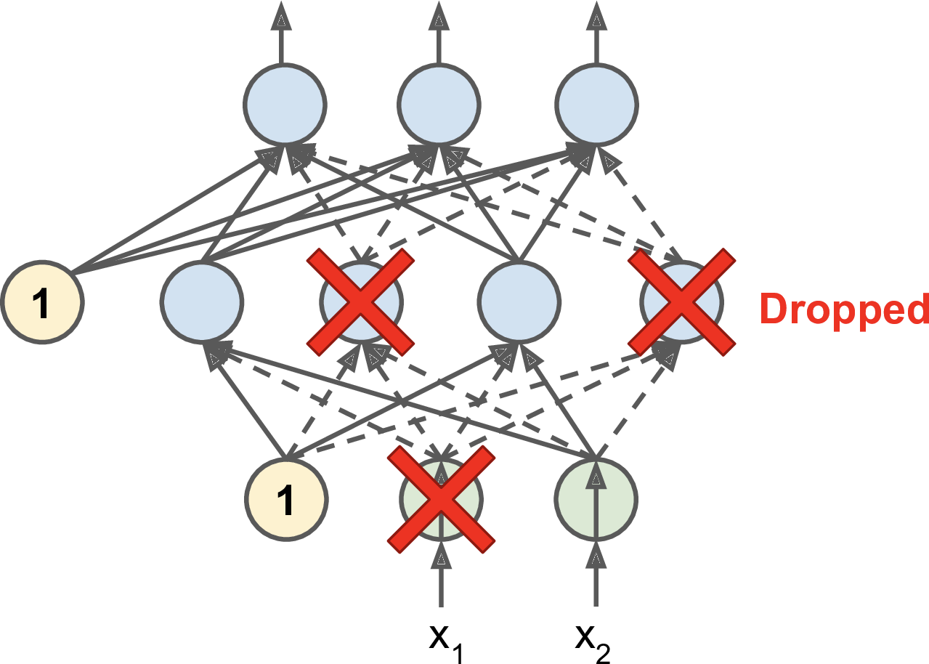
overfitting
Overfitting often occurs when we have a small number of training examples. One way to fix this problem is to augment our dataset so that it has sufficient number and variety of training examples.
It is possible to augment data size by using Keras property of image_gen_train function.
Another technique to avoid overfitting is randomly turning off some of the neurons while training. This is called Dropout, and Keras enables us to use this property in the code
(ex. tf.keras.layers.Dropout(0.5) )

Slide 13
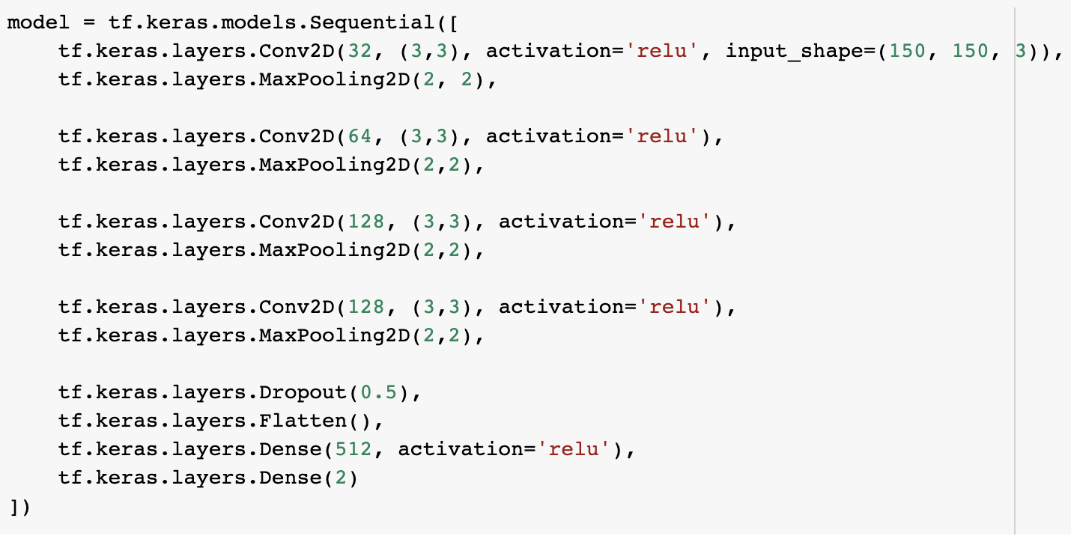
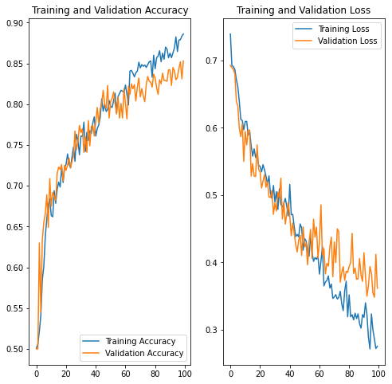
overfitting
Same model, added a dropout layer (50%) and with 1000 more augment images for training.
The validation accuracy have risen from around 70% to 85%.
As a result, Image Augmentation and Dropout greatly reduces overfitting and improves accuracy

Slide 14
How Cnns are used in cybersecurity
There are several studies which show the effectiveness of the using convolutional neural networks and recurrent neural networks together.
For example, in one study; convolutional networks are used to map the network traffic samples of KDD99 dataset [21]. Then, extracted features are fed to recurrent networks of type RNN and LSTM. The convolutional networks with LSTM configuration reached 99,7% accuracy in a two-class scenario of abnormal traffic versus normal traffic. In another study, convolutional networks and LSTM recurrent layers are used together for detecting the intrusions in the DARPA 1998 dataset [22].
In another work; samples in the NSL-KDD are also tested by converting them to an RGB-like formation, then fed to convolutional networks [20]. In this work, it is reported to achieve a better classification performance in RGB like encoding than grayscale [20]

